Slide 1
Miss Blum
Welcome
To
7th Grade!
A new school year brings lots of questions.
Let’s answer those questions and learn about what to expect this year in Miss Blum’s classroom…

Slide 2
Where do I sit?
Sit in your assigned seat.
Be in your seat immediately upon entering the classroom.
Remain seated at all times unless given permission to be up.

Slide 3
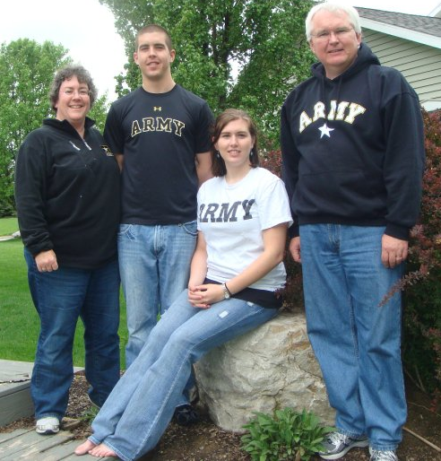
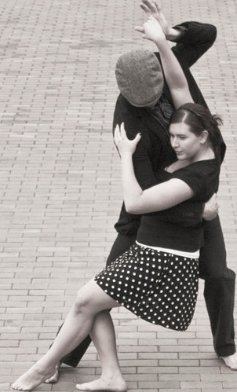
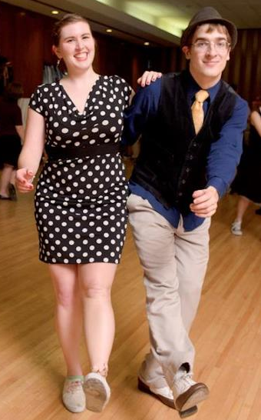
Who is my teacher?
Miss Blum

Slide 4
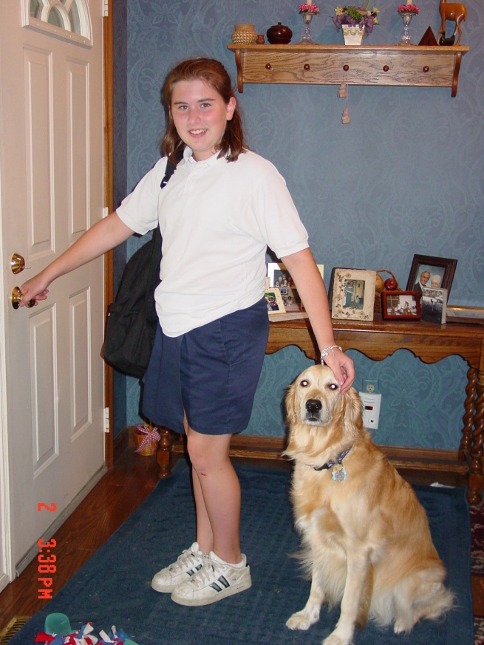
Who is my teacher?
Miss Blum
7th
Grade

Slide 5
What are the Rules?
At All Times…
RESPECT
Yourself, Your Teacher, Your/Other’s Property, Your/Other’s Work (no cheating), The Classroom.
SPEAK IN TURN AND TAKE TURNS SPEAKING
Raise your hand to speak and allow others the opportunity to respond to your words.
BE PREPARED
Have all materials/assignments when you enter the room
*You must bring a “pleasure book” of your choosing for Sustained Silent Reading (SSR)

Slide 6
What are the Rules?
At All Times…
BE ACTIVE
Take responsibility for your own learning. Listen and participate actively in all discussions and activities.
ASK QUESTIONS
If you have a question, someone else is probably wondering the same thing.
TRY YOUR BEST
You will not always understand new concepts immediately, but make an effort to try all assignments and work hard to gain comprehension.

Slide 7
What are the Rules?
At the Beginning of Class…
Say Hello!
Set Homework on Upper Right Corner of Desk
Prepare other necessary materials (sharpen pencil, etc.)
Silently complete bell ringer
Wait for me to begin class.
If you have a question, write it down and hold onto it, raise your hand, and wait for me to call on you after attendance and other tasks are completed.

Slide 8
What are the Rules?
During the Lesson…
Take Proper Notes
Notes should include lesson topic, date and name in upper right corner.
Notes should not be a written script of class, but a shorthand tool for you to understand and remember new concepts.
Listen to and Follow Directions
Directions should not have to be repeated.
Stay Focused
There will be time for short breaks occasionally, but take them only when directed.

Slide 9
What are the Rules?
During the Lesson…
Speak Up!
If I am going too fast, please tell me and I will adjust! Do not be afraid to ask questions, politely request a change of pace, or ask that a concept be explained in a different way.
Remain Seated
Unless otherwise directed, you should remain in your seat throughout class.
Ask Before Leaving
If you need to use the restroom, raise your hand and ask politely, then turn in one of your allotted restroom passes and exit silently.

Slide 10
What are the Rules?
During Work Sessions…
Silence (unless otherwise directed)
During Partner/Group Work
Stay focused and on task
Be respectful of other’s thoughts
Help one another (do not give answers)
Ask 3 Before Me
Raise Your Hand (do not follow me around the room – I will come to you)
Clean Up (Leave your area straightened and cleaned – better than the way you found it.)

Slide 11
What are the Rules?
What if I finish early?
Help others
SSR time
Work on homework
All English/Reading homework should be completed first. When all ENG/READ homework is completed, you may work on assignments for other classes.
**Important Note: I end class, not the clock. You are expected to be productive until I release you.

Slide 12
What You Can Expect
Expect to write every day. (Short reflection essays, quick bell ringers, journal entries, etc.)
I will try to allow time to begin your homework at the end of class, but do NOT rely on this time to complete assignments. This work time is earned by good behavior and ability to complete the day’s lesson on time/early.
Clear expectations for assignments with rubrics for major projects.
Informative Feedback I will take the time to write you descriptive feedback on all written assignments/essays to help you improve. Because I am taking the time to help you individually, I expect you to take the time to read these comments and reflect on how you can improve.

Slide 13
HOMEWORK
This is your chance to check your understanding of new concepts and practice what we cover in class.
Homework is due the day after it is assigned unless otherwise directed.
Most homework assignments will be graded for completion. I expect a solid effort on every assignment. If proper attempts are not being made on homework assignments, they will be graded for correctness. (You will receive a warning if this change occurs.)
Policies

Slide 14
HOMEWORK
Policies
Take pride in your work! Cross-outs, scribbles, and poor quality of an assignment may result in point deductions on an otherwise well-completed assignment.
All assignments should be written in your planner.

Slide 15
Late Work
Policies
Assignments incomplete at the beginning of class are considered late. All assignments are expected to be completed, whether on time or late.
10% deduction per day late up to the 5th day. After 5 days, the assignment is worth 50%. (50% is better than a zero!)

Slide 16
Absent Work
You have one day for every day of absence to complete and turn in assignments – this includes quizzes and tests. (ex: If you are sick for two days, you have two school days to hand in missed work.)
After your absent deadline, the late work policy will go into effect. (10% per day)
* Exception = Long-term projects. These deadlines are announced well in advance and are expected to be turned in on time regardless of absence.
Policies

Slide 17
Grading
Policies
Grades are based upon a percentage of correct answers over the total possible.
Grades are a compilation of points based upon assignment completion, major projects, papers, tests, exams, quizzes, and class participation. (Participation does not simply mean always raising one’s hand to answer, but also includes demonstrating active listening skills.)

Slide 18
Grading
Policies

Slide 19
Grading
Policies
Points and percentages are averaged and correspond to letter grades as follows:
95-100% = A
93-94% = A-
91-92% = B+
87-90% = B
85-86% = B-
83-84% = C+
80-82% = C
78-79% = C-
76-77% = D+
72-75% = D
70-71% = D-
Below 70% = F

Slide 20
Tardy
Policies
Passes will be required by all students not in the classroom at 8:10a.m.
Tardies not accompanied by a doctor’s note mean the assignment/s missed cannot be made up, and homework is considered late if not checked on time.

Slide 21
Additional
Policies
I do not compete! – If I’m talking, you are not.

Slide 22
What you need to know
What’s Mine and Why
Time and How Much is Mine
- class time is my time, not any other subject or social
Texts and Workbooks
- must be covered by Monday. (Book sacs may be used this year IF they are size appropriate.
- All covers/folders/bags/etc. must remain free of markings, notes, doodles, etc. Only name and subject are acceptable.
Uniform Game!
Tornado/Fire Drill Procedures
Headings on Papers, Assignment Policy
Stairs and Hallway Practice
Prayer
Day 1

